Slide 1
Group 19 Progress Update
2nd Mentor Meeting – 21/02/23

Slide 2
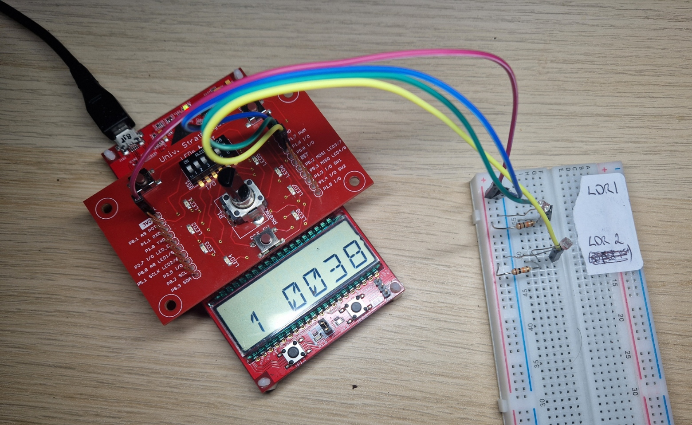
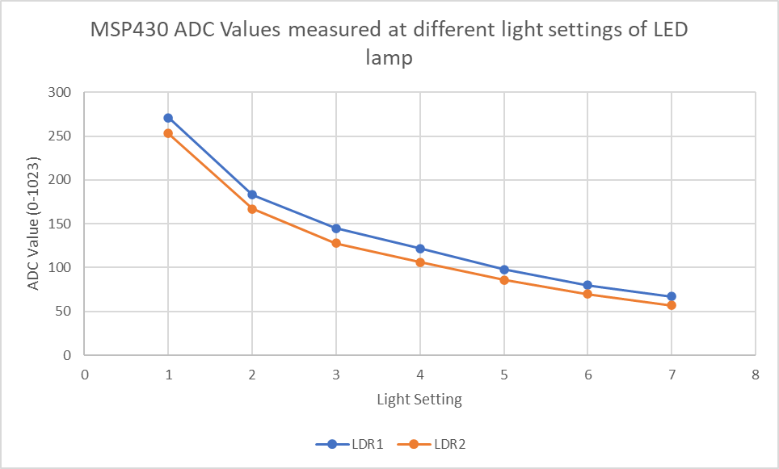
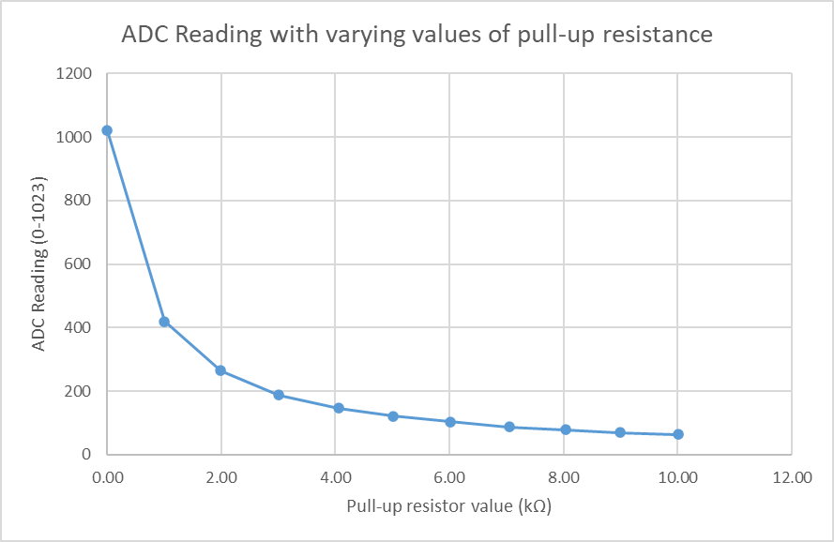
LDR Testing
Can read values from multiple LDRs
Completed testing – discovered reason for strange values.
Once solved both the LDRs measure almost the same value – just slightly offset.
Found effect pull-up resistance value has on reading.

Slide 3
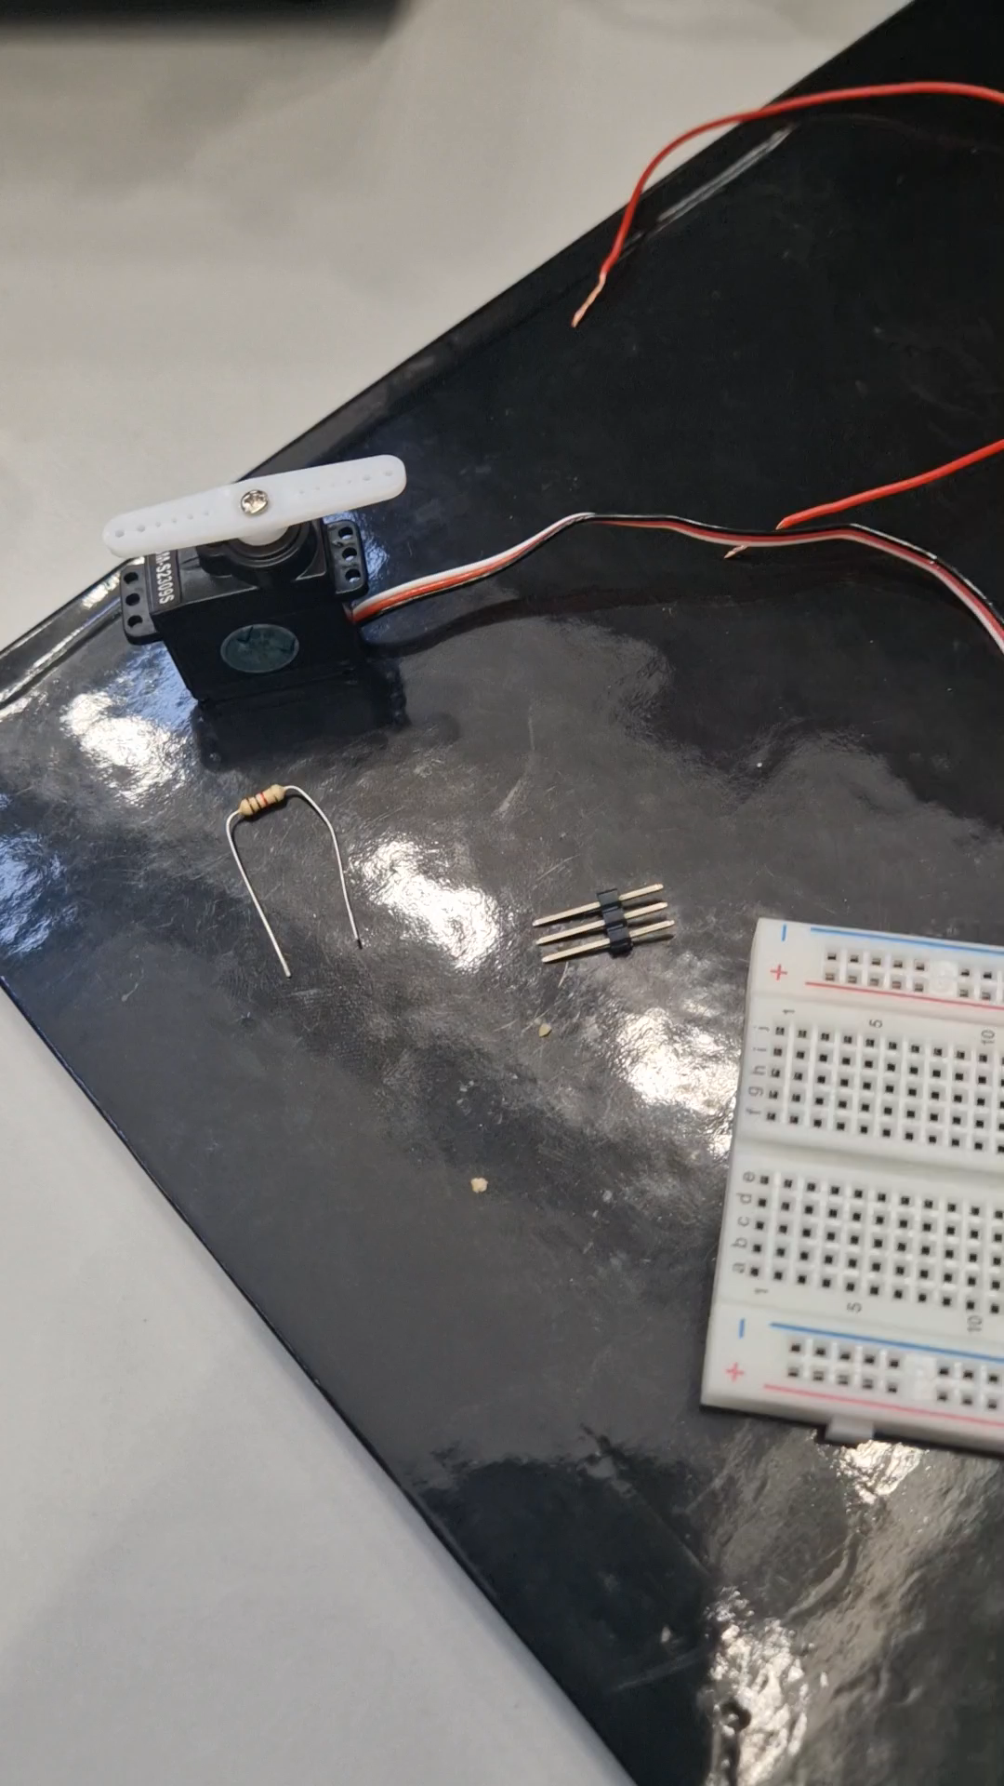
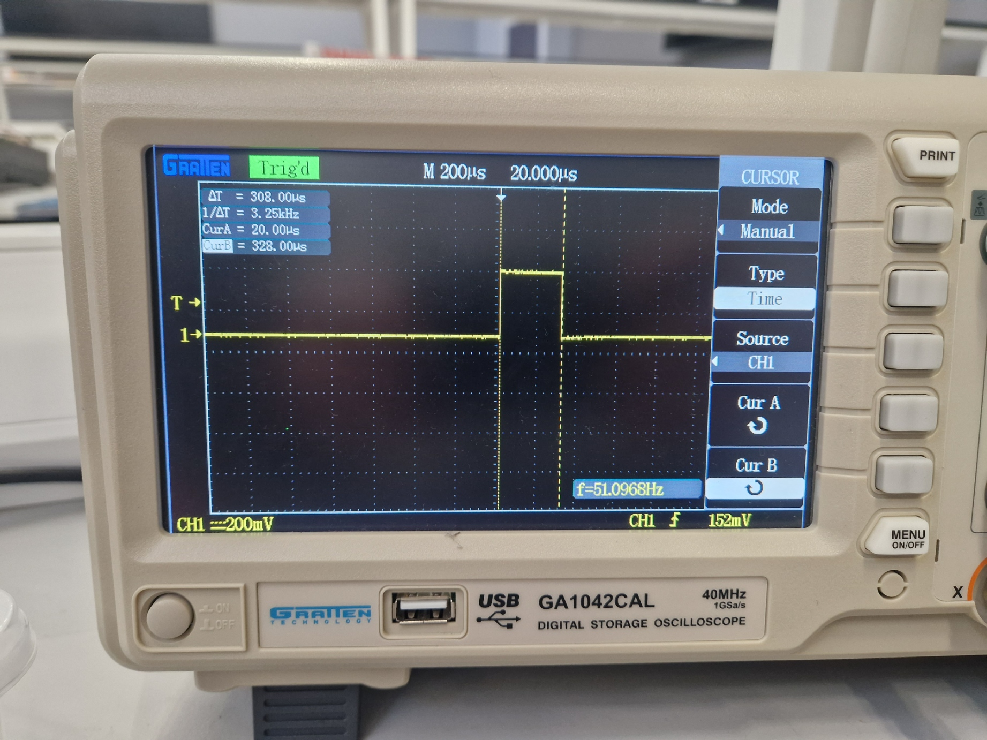
Servo Control
All research into PWM and servo motor control has been concluded
Servo motor control was achieved.
Servo motor testing will be concluded today – with the pulse periods required to reach limits.

Slide 4
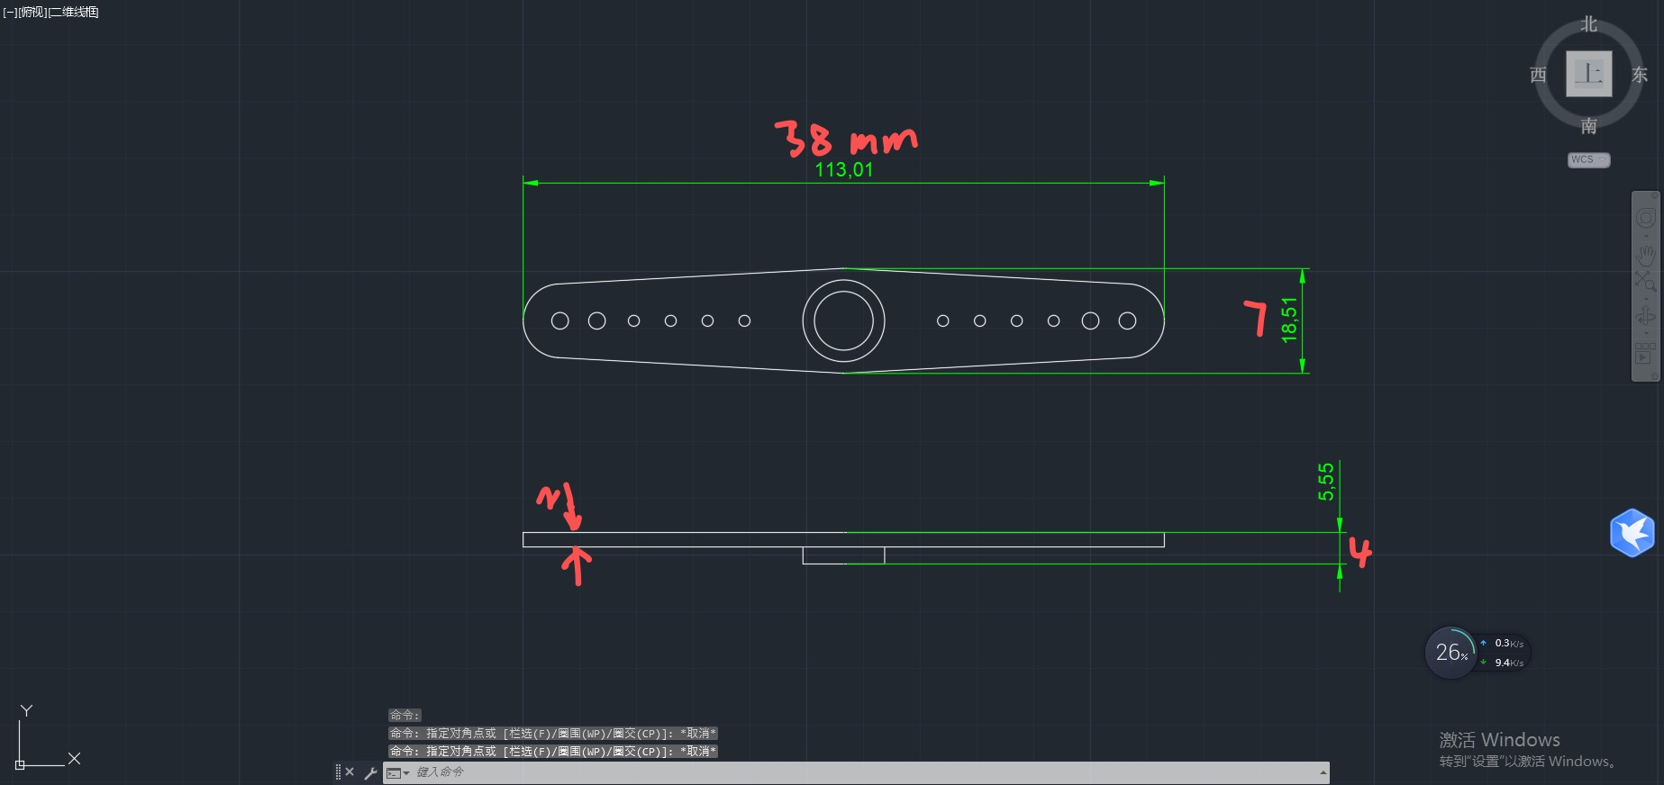
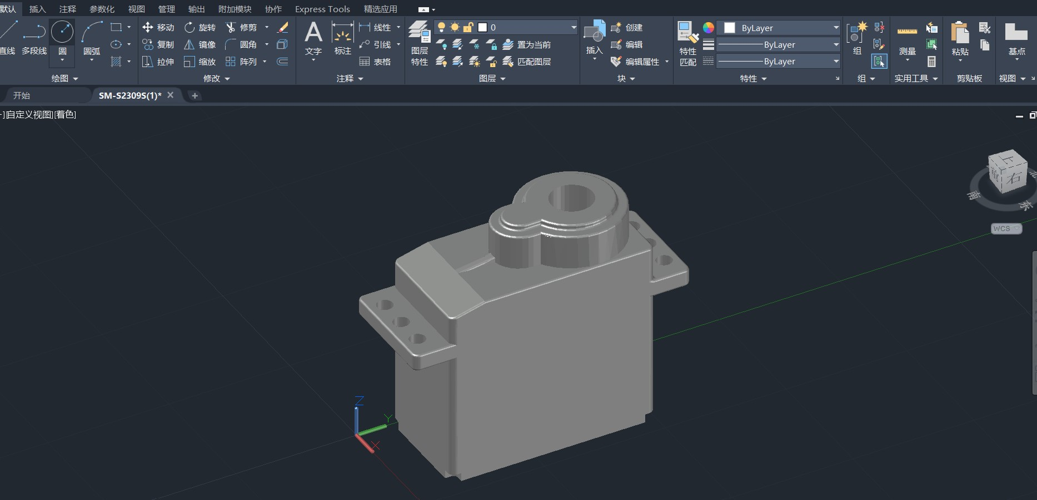
CAD for servo motor fans(ing)

Slide 5
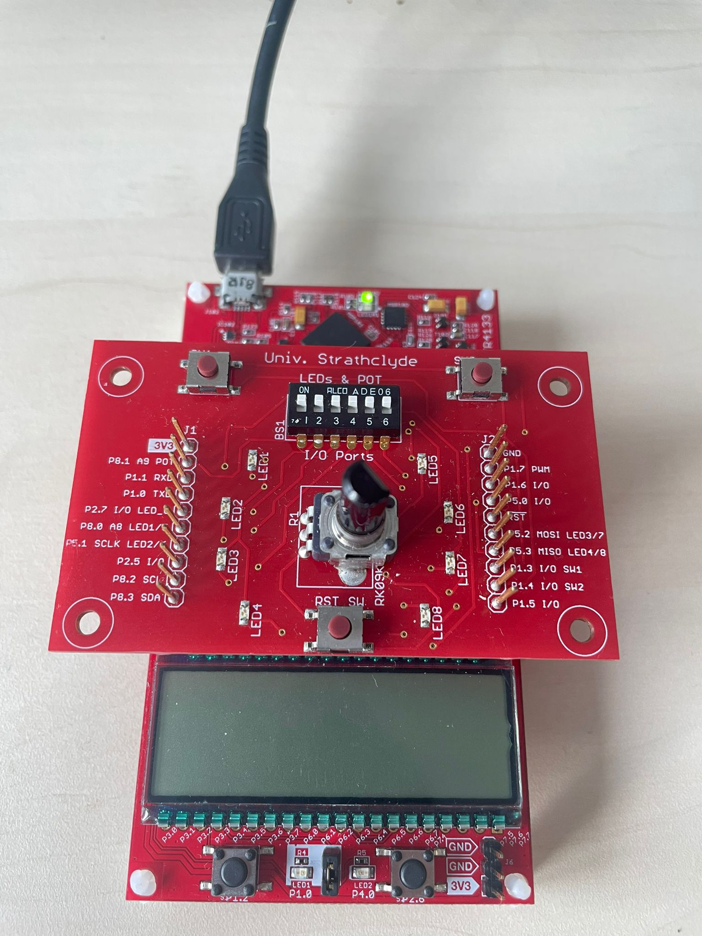
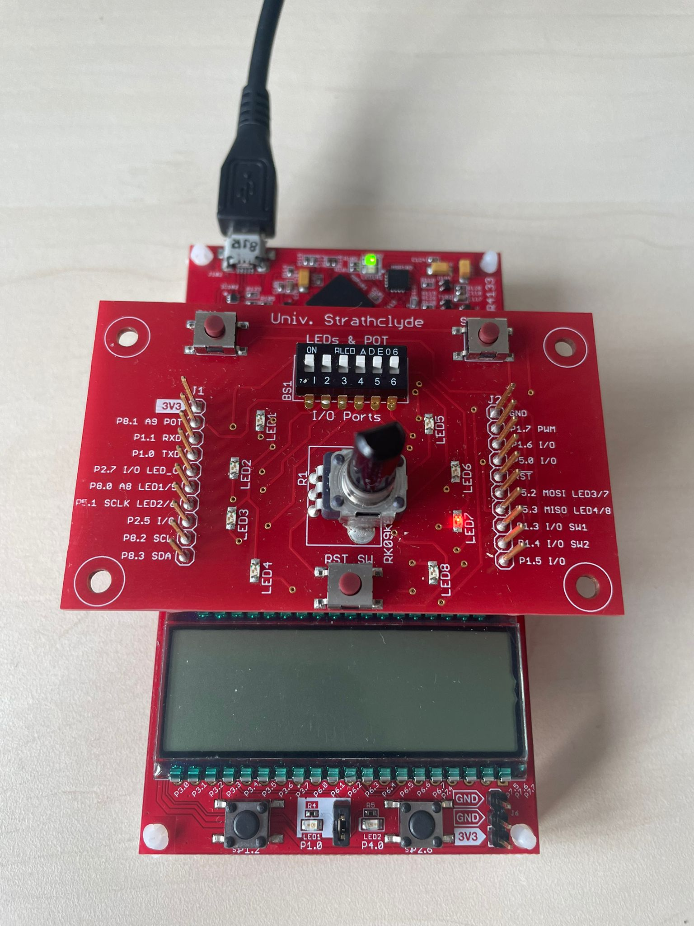
Voltage Measurement
<0.5, NO LEDs
Configured the MSP430 to measure voltage using the ADC for it and the Pot. As a testing element.
The code will turn on the LEDs once a certain value of voltage is measured.
E.g., if the voltage measured is >2.5, then LEDs will light up, this value will be reached by turning the potentiometer.
The potentiometer was linked to the ADC measurement through the A9 pin.
>0.5, LEDs On

Slide 6
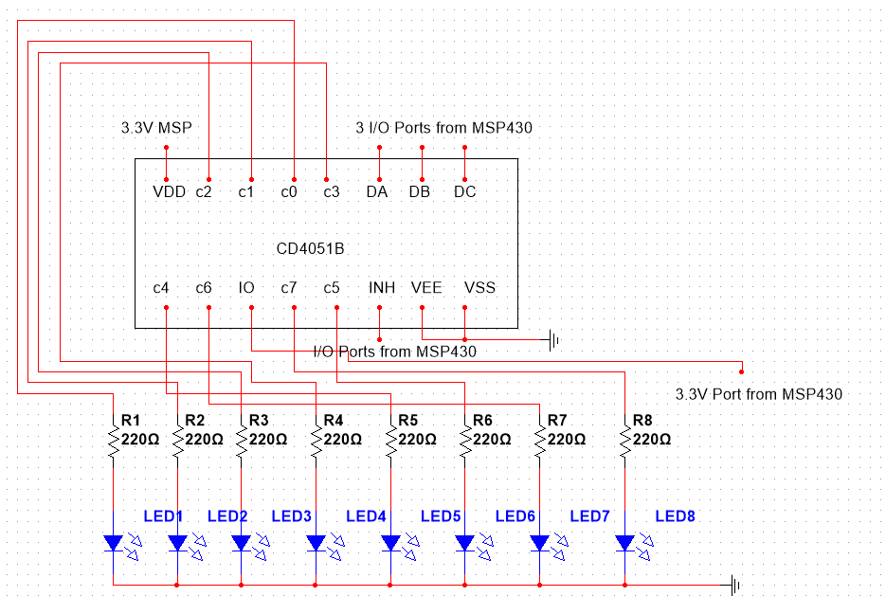
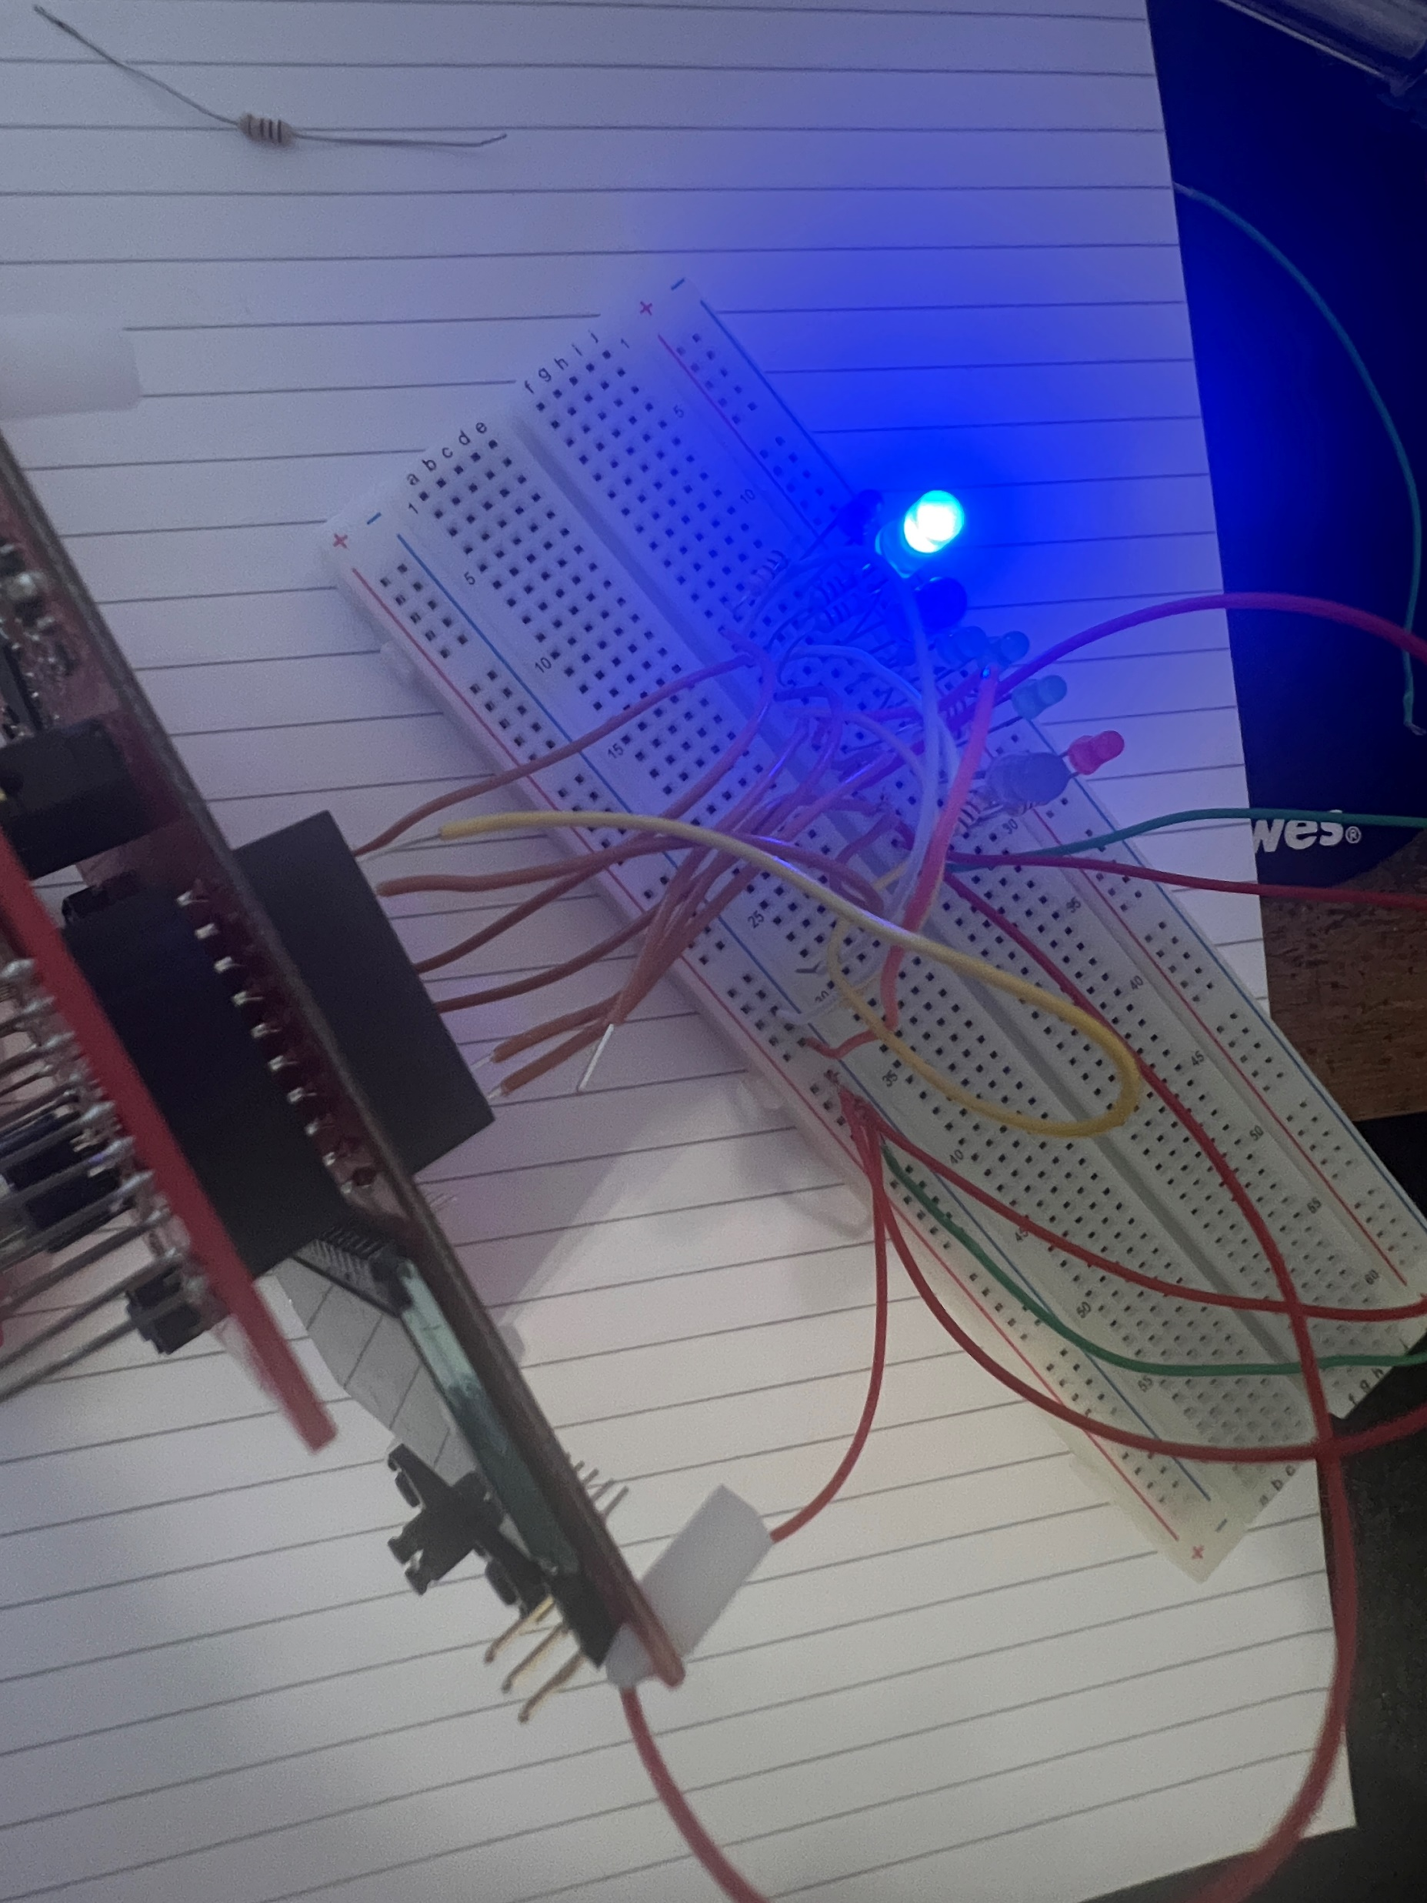
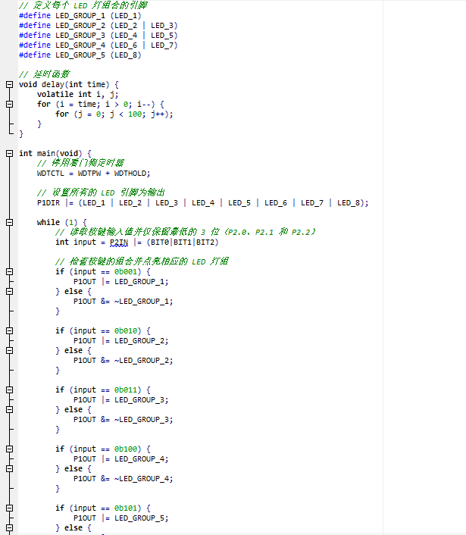
LED Indicators (with 8x1 multiplexer)

Slide 7
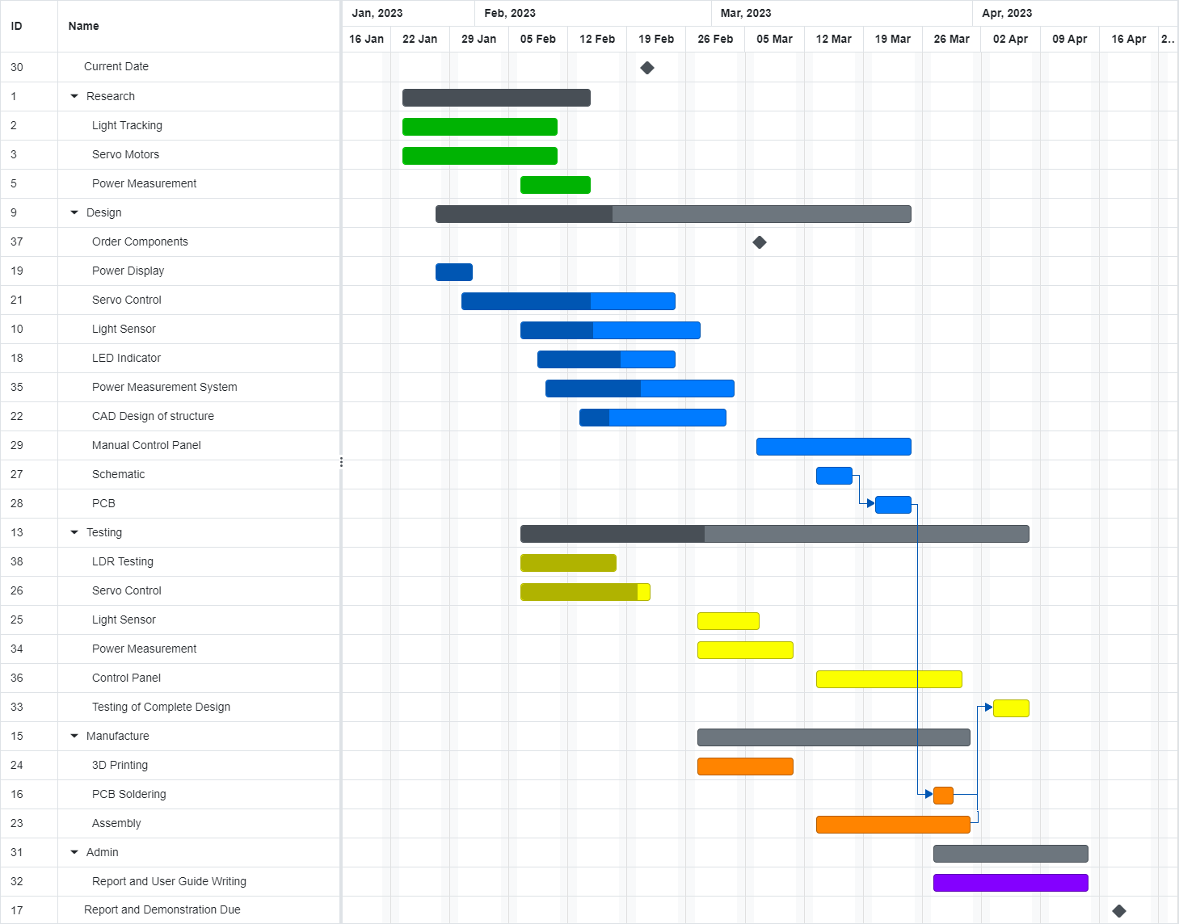
Project Plan

